Slide 1


設備異常偵測模型於時間序列資料之研究
Constructing Anomaly Detection Model for
Time Series Data and Empirical Study
人工智慧與決策分析研究室 (AIDA)：
許嘉裕、莊佳臻
日期 : 2023/08/29

Slide 2

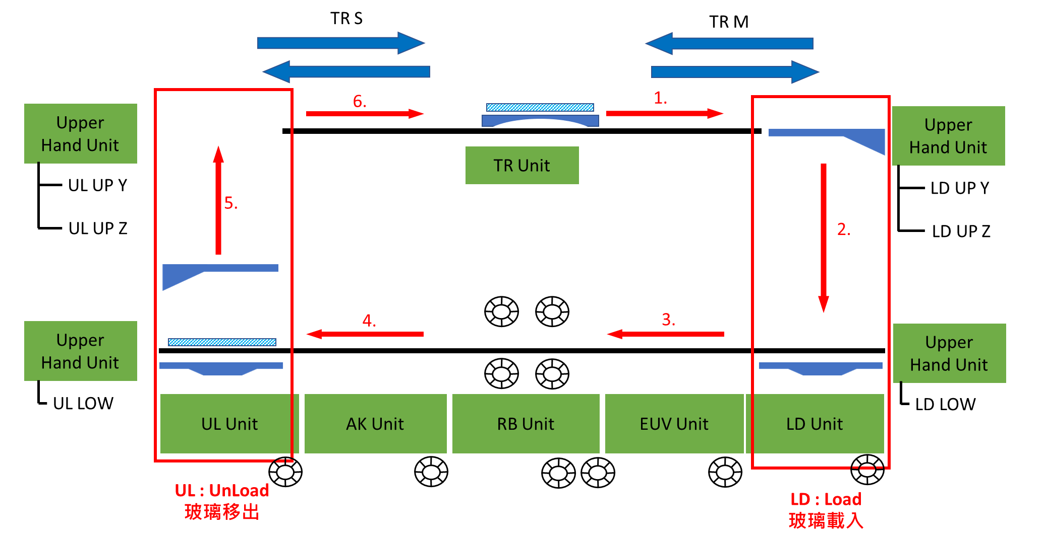
Background
Introduction
Proposed method
Experiment result
Conclusion
The goal of this study is to establish a real-time anomaly detection model for DMS cleaning machines that will enable constant machine state monitoring.
The collected data lacks sufficient labels and is mostly comprised of normal state sample. Therefore, the construction of an anomaly detection model needs to be carried out using only normal state data.
Further losses may be effectively mitigated if problems are quickly identified and the proper actions are then implemented based on the relevant decision criteria.
2

Slide 3
Introduction
Proposed method
Experiment result
Conclusion
Situation description
Situation |  | Challenge | Solution
Data collection | DMS cleaning machine Robot torque data 7 axis Collection frequency： once pre second | Insufficient labeled samples The utilized data only consists of samples in normal states. The data exhibits shifts in both time duration and torque magnitude Performing anomaly detection without sufficient labeling. | Utilizing unsupervised learning methods. Utilizing generative models for auxiliary modeling of normal state samples. Performing anomaly detection of various types using shape indicators, distribution indicators, and instantaneous indicators. Establishing a multi-faceted unsupervised anomaly detection framework.
Data characteristics | Single feature(torque) sequential data
Target | Real-time monitoring of DMS cleaning machine
3

Slide 4
Introduction
Proposed method
Experiment result
Conclusion
Execution Results
 | As-Is | To-Be | Benefit
生成資料混合訓練 | 設備異常的紀錄鮮少 | 生成正常樣本和真實數據資料進行混合訓練 | 使異常偵測模型能學習正常樣本完整之資料輪廓 改善決策邊界樣本的偵測能力。形狀指標漏檢率有8% - 63% 的下降，分佈指標下降15%-48%
異常偵測 | 傳統監督式學習方法 非監督式機器學習方法 | 使用非監督式深度學習框架LSTM-DAGMM，透過深度學習模型在學習時間序列資料非線性特徵同時擬合正常資料之資料分佈 將資料進行時域特徵之轉換，觀察序列在短時間變化之表現 | 非監督式學習無須進行資料標記 DAGMM透過深度學習之特性進行重構學習和密度估計的聯合優化。壓縮網路進行序列表現的學習，估計網路進行資料分佈之學習 時域轉換特徵捕捉正常狀態下瞬時變化之界線
 | 單一指標進行異常偵測 | 建構三種異常偵測指標進行偵測，DAGMM生成形狀指標以及分佈指標，瞬時指標由時域特徵轉換而成，由三種指標進行多面向異常偵測。 1.形狀指標：序列原始表現之異常 2.分佈指標：序列潛在特徵分佈之異常 3.瞬時指標：序列在短時間變化之異常 | 利用三種指標進行多面向之異常偵測，三種指標能夠互補相互不足的地方。和以往單一面向進行偵測的方法相比，準確率平均能達到9成
4

Slide 5
01
Introduction
02
Proposed method
Content
03
Experiment result
04
Conclusion

Slide 6
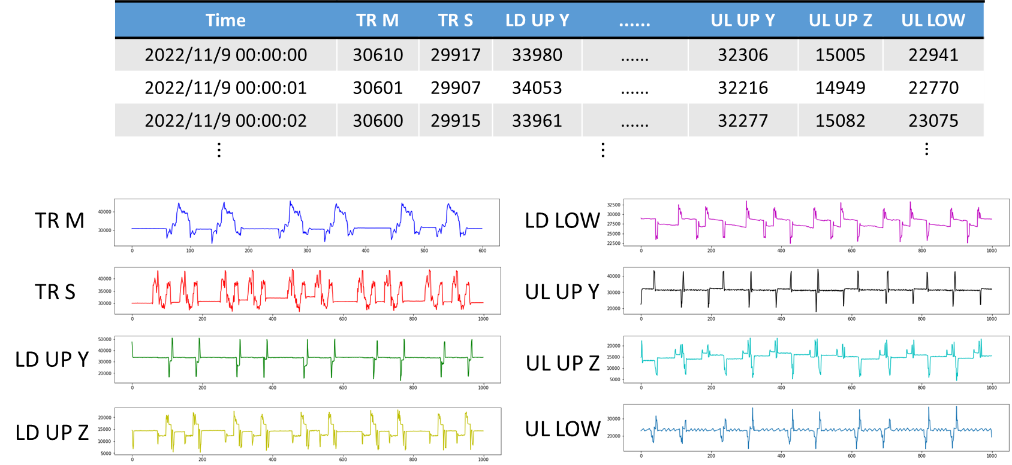
DMS cleaning machine – data description
Introduction
Proposed method
Experiment result
Conclusion
Axis name | Collection time | Sample quantity | Sequence length(s)
TR UNIT | 2022/11/09-2022/11/15 | 4836 Samples | 55
LD UP Y |  | 3706 Samples | 26
LD UP Z |  | 3439 Samples | 50
LD LOW |  | 3528 Samples | 60
UL UP Y |  | 2580 Samples | 45
UL UP Z |  | 3578 Samples | 80
UL LOW |  | 3321 Samples | 20
6

Slide 7

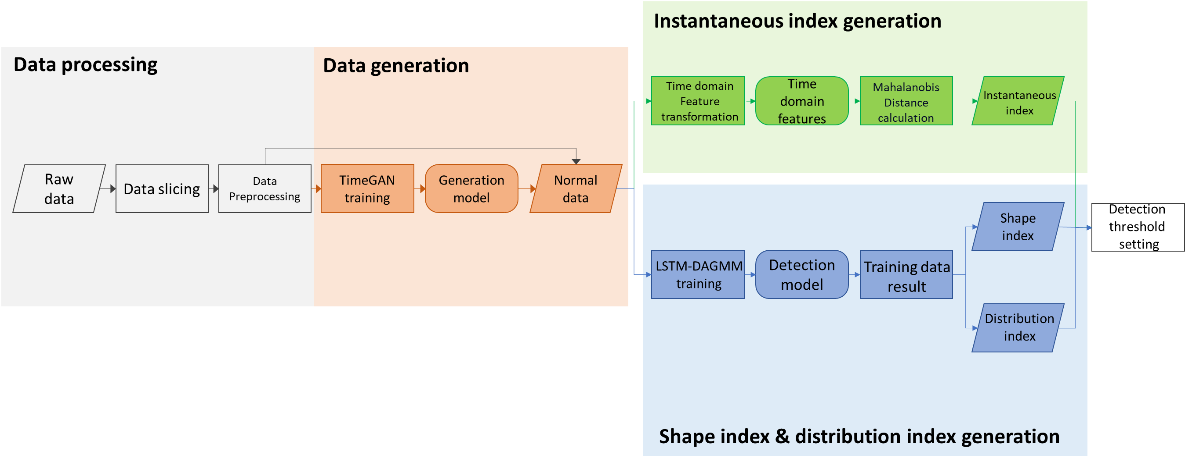
Introduction
Proposed method
Experiment result
Conclusion
Propose Method – training stage
7

Slide 8
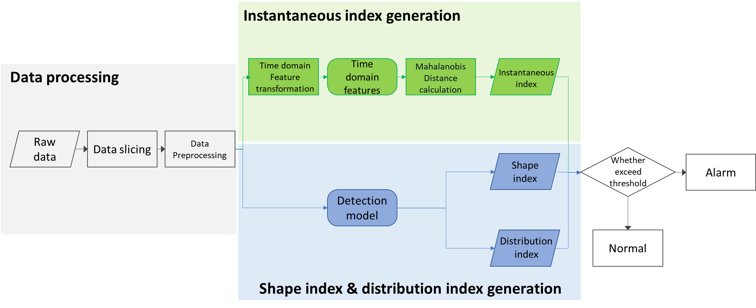
Introduction
Proposed method
Experiment result
Conclusion
Propose Method – inference stage
8

Slide 9
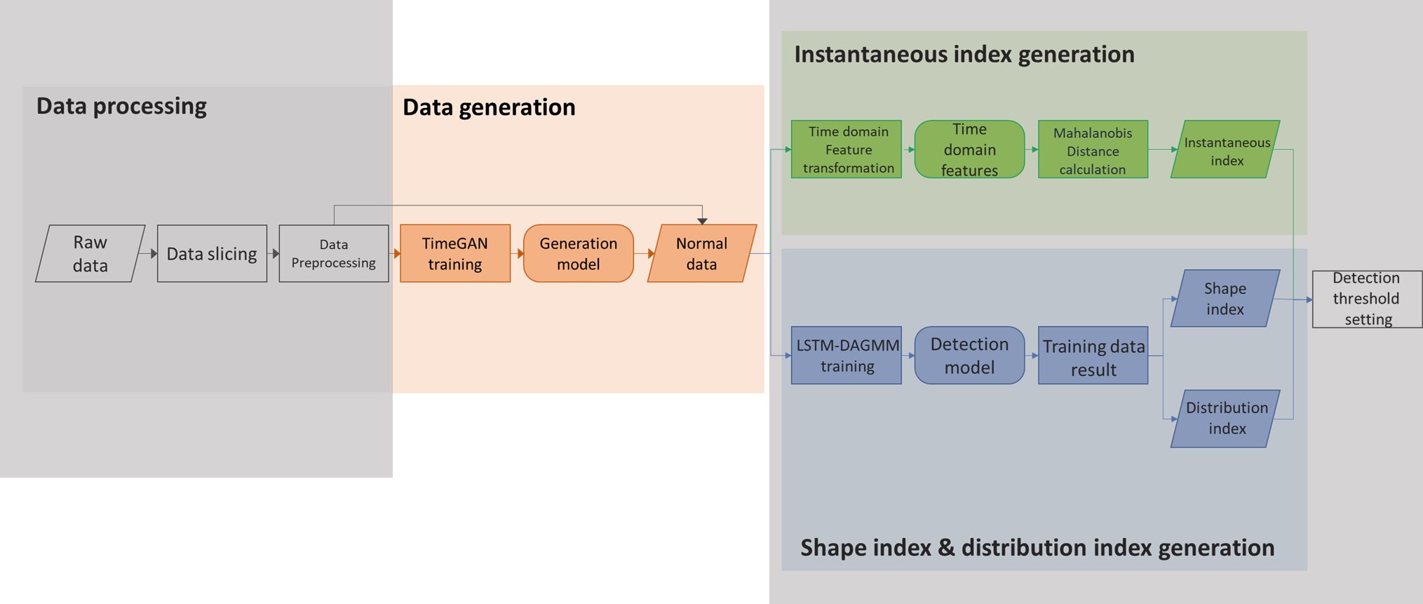
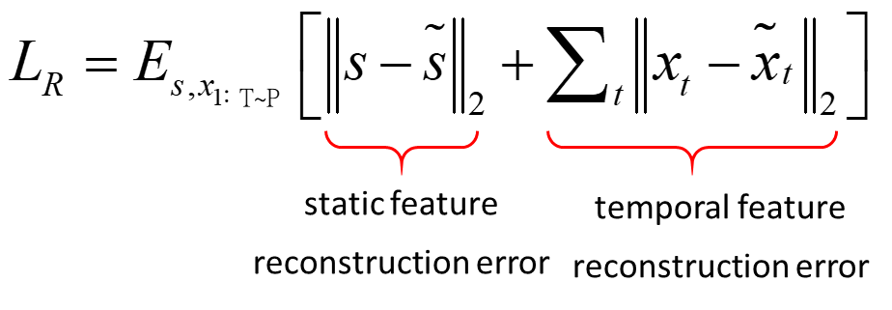
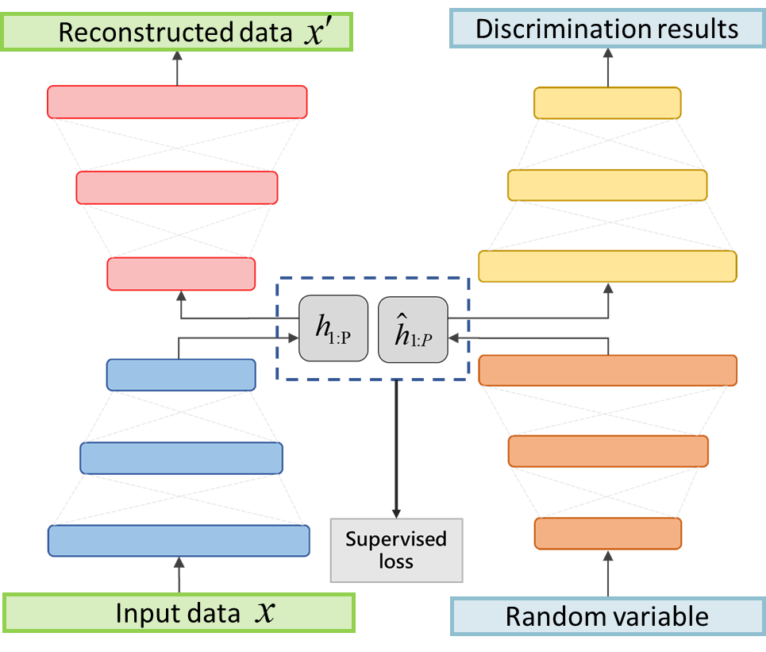
Introduction
Proposed method
Experiment result
Conclusion
Data Generation - Time-Series GAN
Reconstructed loss
Encoding learning
(Yoon et al. 2019)
Step 1.
Autoencoder component training
Recovery network
Discriminant network
Unsupervised loss
Data generation
Step 2.
adversarial generation component training
Embedding network
Generate
network
Supervised loss
Step 3.
Joint learning
9

Slide 10
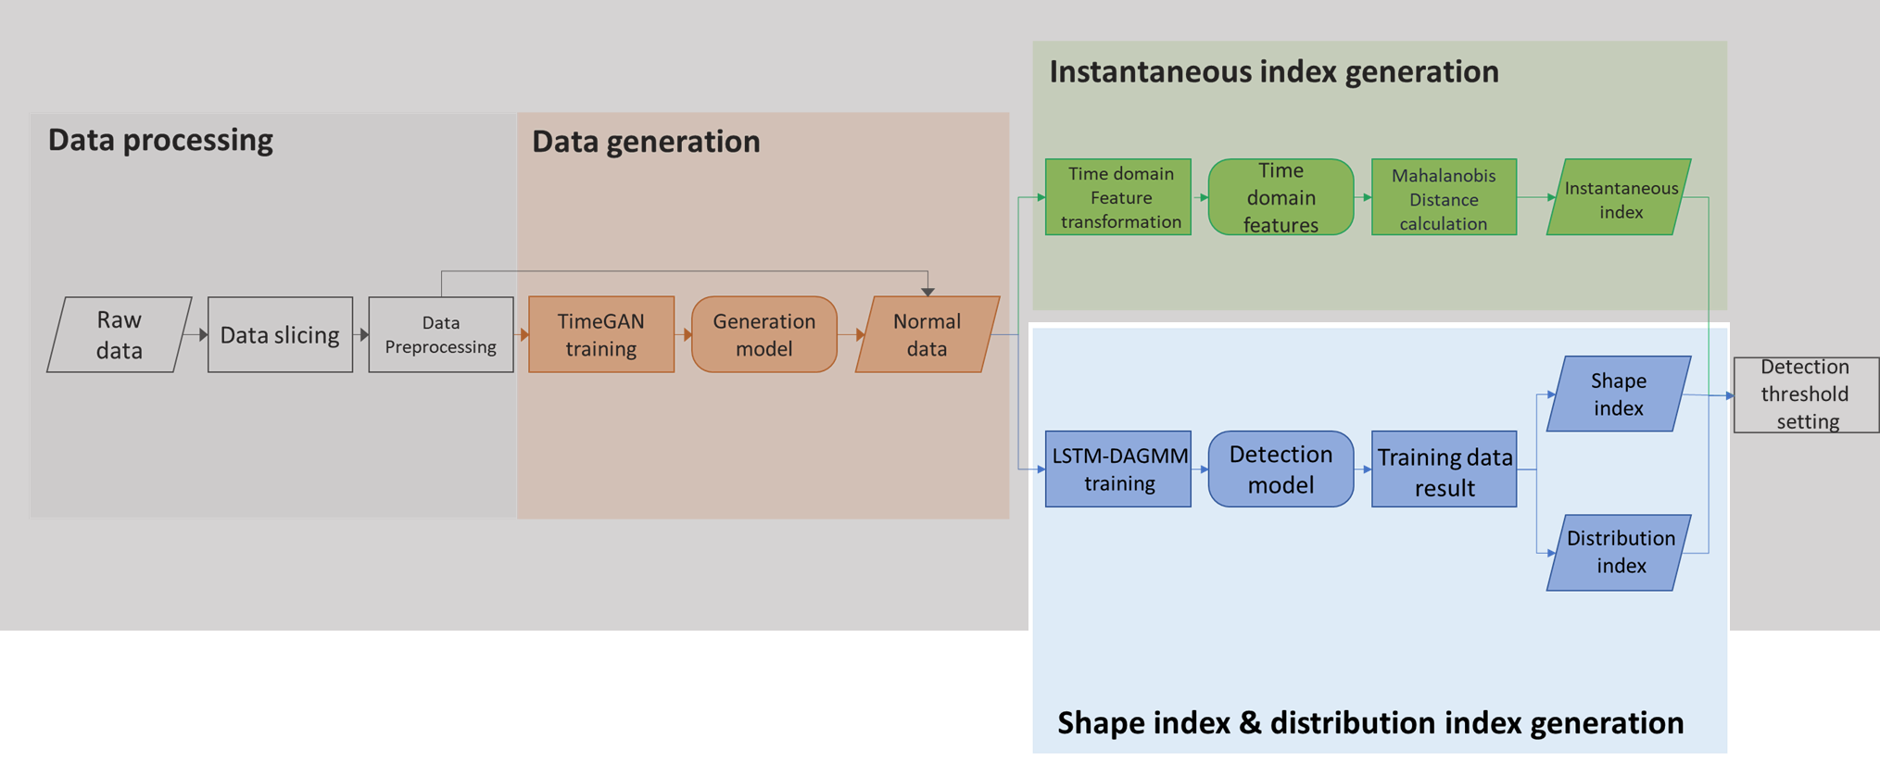
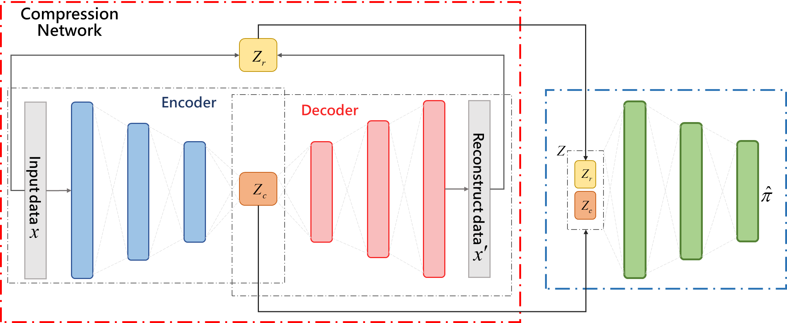
Introduction
Proposed method
Experiment result
Conclusion
Anomaly Detection - DAGMM
( Zong et al. 2018)
Compression network
Dimensionality reduction and low-dimensional feature space construction.
Output：sequence similarity and latent space feature .
Where sequence similarities are :
Estimation network
Density estimation via reconstruction error and low-dimensional features.
Output：Mixed composition .
DAGMM optimizes the learning of dimensionality reduction and density estimation at the same time by joint training.
10

Slide 11
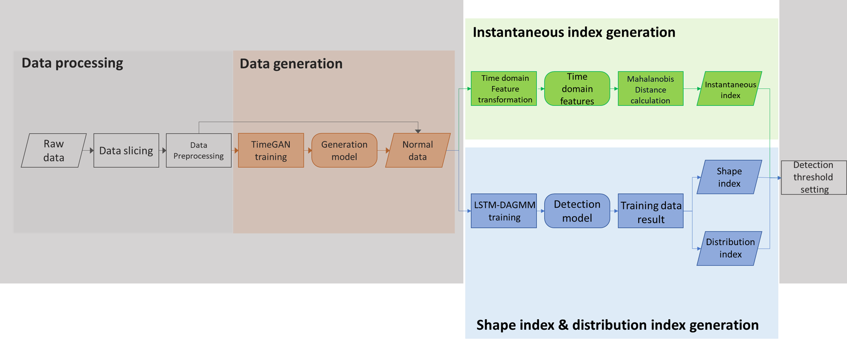
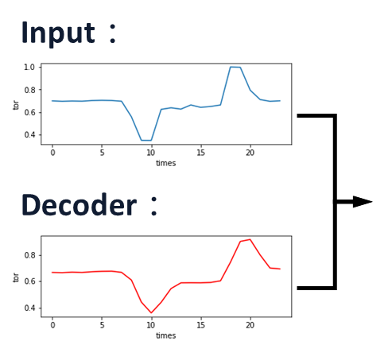
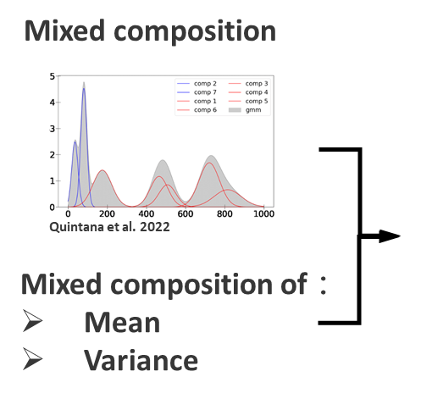
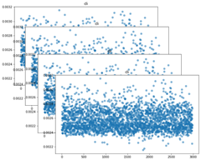
Introduction
Proposed method
Experiment result
Conclusion
Monitor strategy
Shape indicator：
Determine if the samples exhibit unexpected performance in the original space by MSE .
( Compression network )
Estimation network
Distribution indicator：
The calculation of the NLL. A higher value indicates a poorer match with the model.
( Estimation network )
Instantaneous indicator：
Obtaining by Mahalanobis distance and time-domain features, determine small and short changes in series.
( Time domain features similarity)
Time domain feature
11

Slide 12
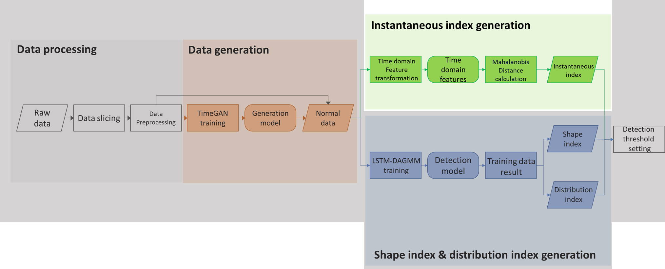
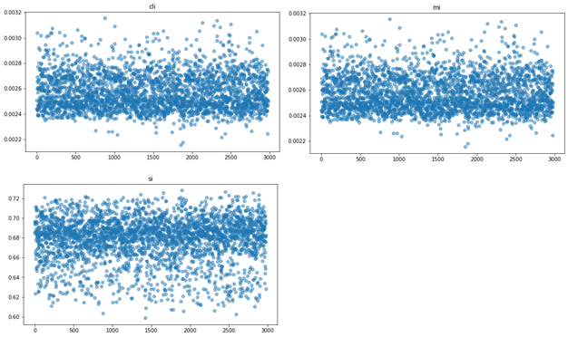
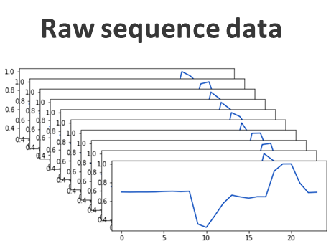
Introduction
Proposed method
Experiment result
Conclusion
Monitor strategy - instantaneous indicator
Time domain feature transformation
Statistic feature | Maximum
 | Minimum
 | Standard deviation
Sequence feature | p to p value
 | peak index
 | crest factor
 | clearance factor
 | shape factor
 | impulse factor
Set mean as central by feature
Time domain feature
……
……
Mahalanobis distance calculation
Instantaneous indicator

Slide 13
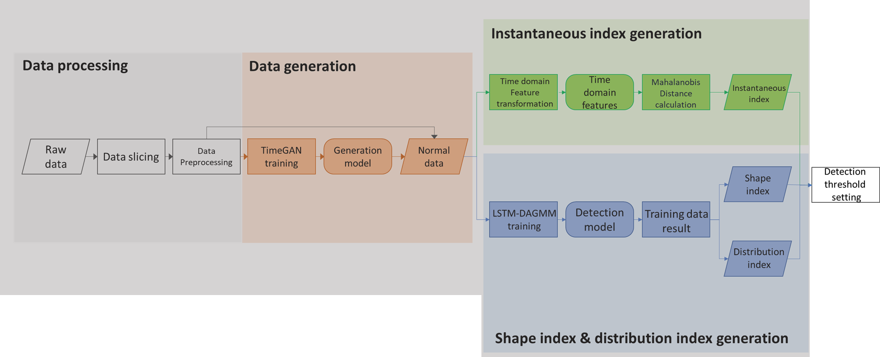
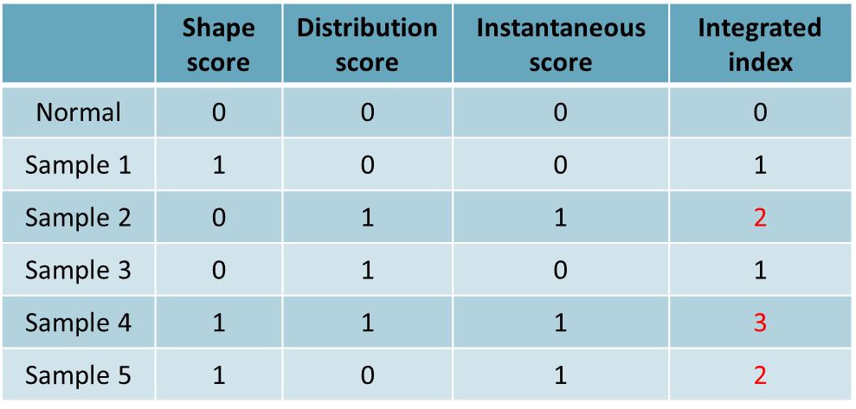
Introduction
Proposed method
Experiment result
Conclusion
Monitor strategy – integrated index
Where :
For each indicator :
If indicator exceed threshold → indicator score = 1
For example :
Shape indicator：
If shape indicator exceed threshold → Shape score = 1
Else shape score =0
After score transformation, each indicator score will be concatenate as state array .

Slide 14
Introduction
Proposed method
Experiment result
Conclusion
Monitor strategy – Anomaly value
Transformation：
Detection result：
 | Shape indicator | Distribution indicator | Instant indicator
Maximum | 0.0510 | 2.4985 | 0.0165
Thresh | 0.0109 | -21.40 | 0.0020
Minimum | 0.0030 | -23.1839 | 0.00005
 | Shape value | Distribution value | Instant value | Integrated index
Normal | 0.0927 | 0.0042 | 0.0858 | 0
Thresh | 0.1759 | 0.0805 | 0.1274 | 0
Sample 1 | 0.0441 | 0.1269 | 0.0124 | 1
Sample 2 | 0.1172 | 0.0210 | 0.1478 | 1
Sample 3 | 0.3993 | 0.0969 | 0.6750 | 3
Sample 4 | 0.0156 | 0.0478 | 0.0808 | 0
 | Shape value | Distribution value | Instant value
Maximum | 1.0000 | 1.0000 | 1.0000
Thresh | 0.1759 | 0.0805 | 0.1274
Minimum | 0.0000 | 0.0000 | 0.0000

Slide 15
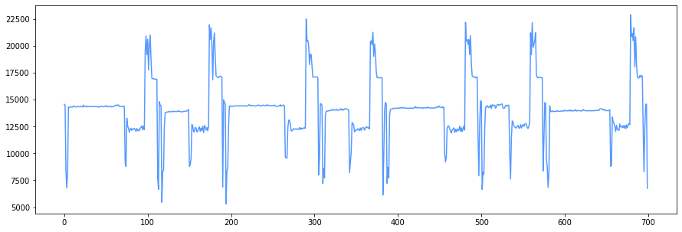


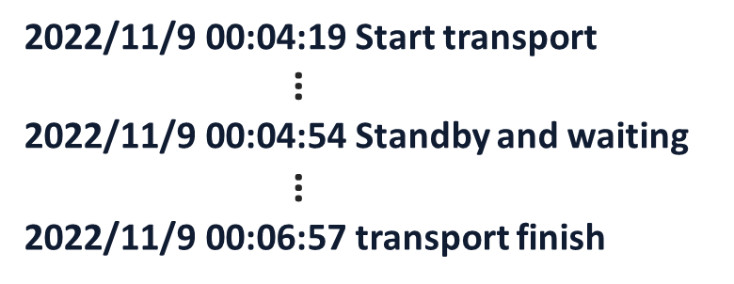
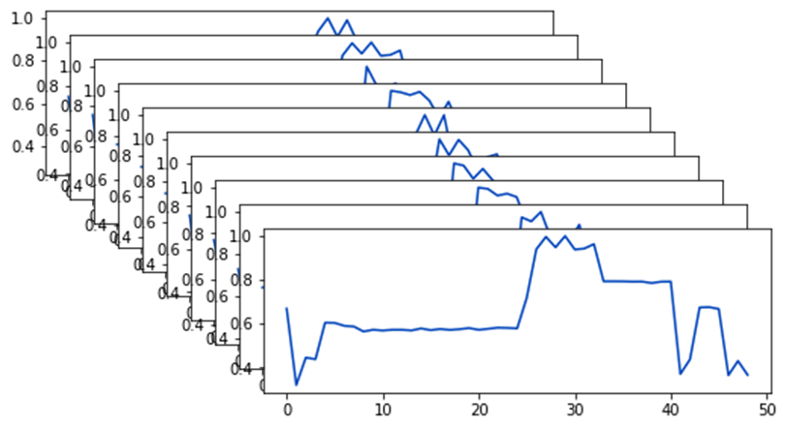
Introduction
Proposed method
Experiment result
Conclusion
Data description – LD LOW
By robot operating cycle
 | TimeGAN | LSTM-DAGMM
Training set | 2943 | 5958 | 2943(real data)
 |  |  | 2943(TimeGAN)
Validation set | - | 445
Test set | - | 704
Sequence length | 60 | 60
Torque sequence data
……
15

Slide 16
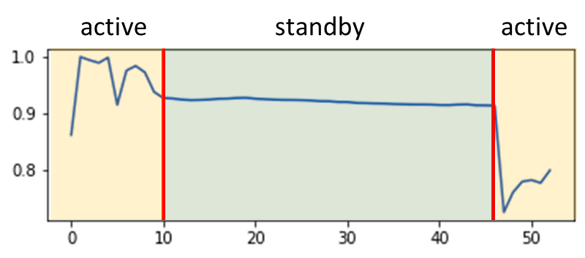
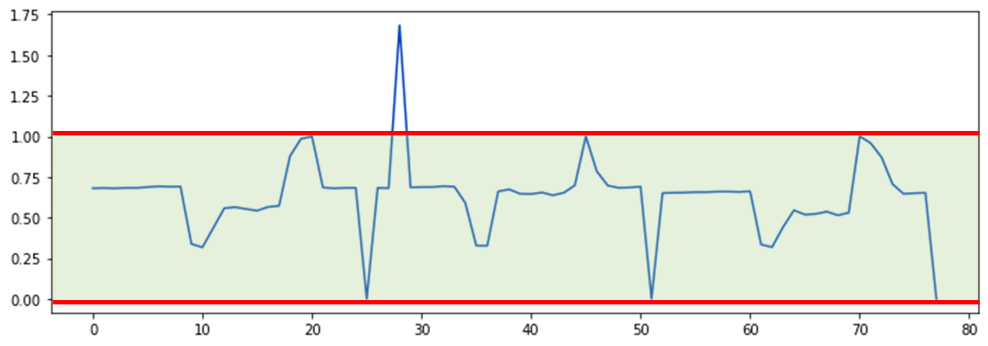
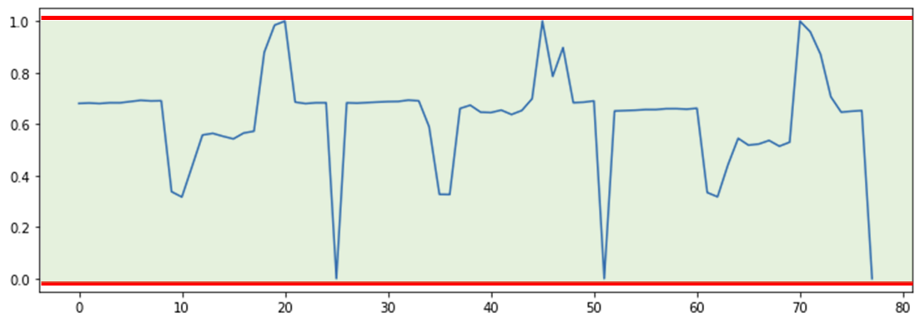
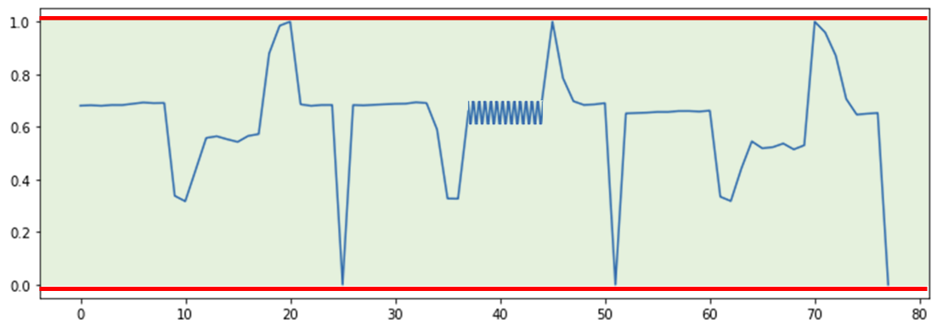
Introduction
Proposed method
Experiment result
Conclusion
Experiment design
Point abnormality
Choi et al., 2021; Blázquez-García, A et al
Operation | factor
Standby | Belt
Carrying | Bearing Slider
Complexity | Belt & bearing Belt & slider
Contextual abnormality
Choi et al., 2021; Blázquez-García, A et al
Based on the machine‘s operating principles and combined with normal signal data, design abnormal samples. corresponding to the following types of anomalies：
Contextual abnormality.
point abnormality.
sequence abnormality.
Sequence abnormality
16
Choi et al., 2021; Blázquez-García, A et al

Slide 17
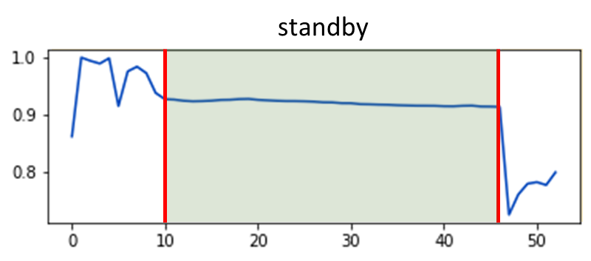
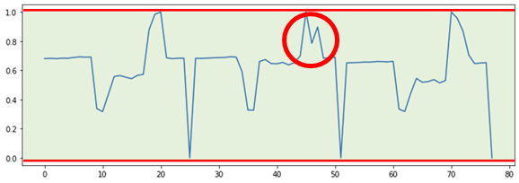
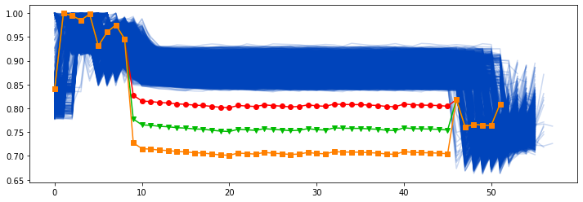
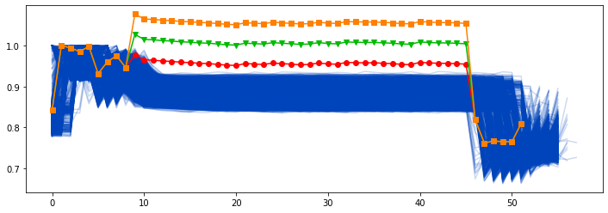
Introduction
Proposed method
Experiment result
Conclusion
Experiment design - Standby section abnormality
Standby section abnormality can be determined as Contextual abnormality.
Loose belt
tightened belt
17

Slide 18
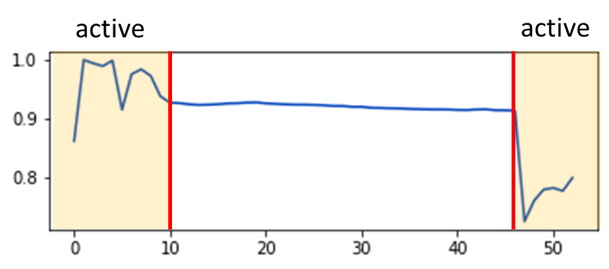
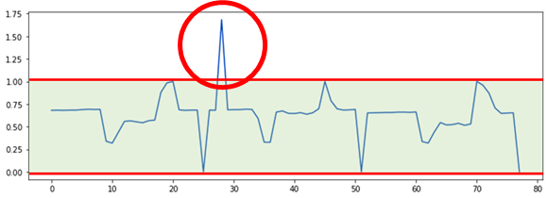
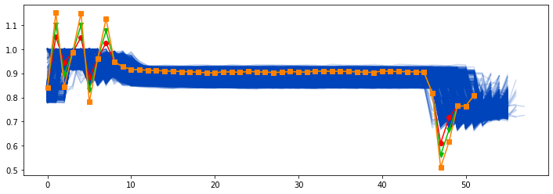
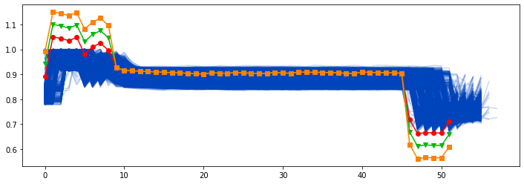
Introduction
Proposed method
Experiment result
Conclusion
Experiment design - Carry section abnormality
Carry section abnormality can be determined as point abnormality.
Sequence design：slider
Point design：bearing
Slider loose
Bearing loss
18

Slide 19
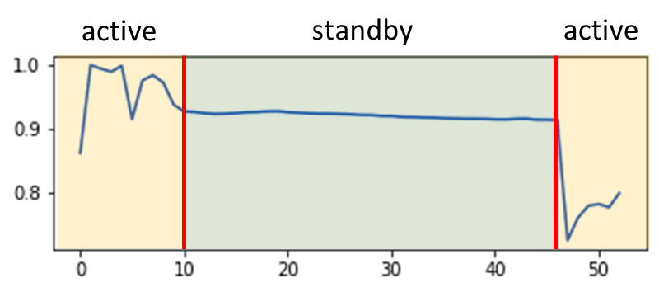
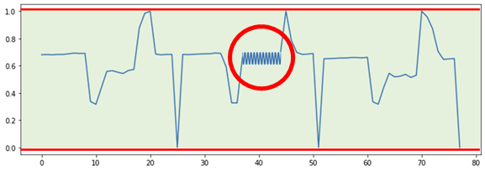
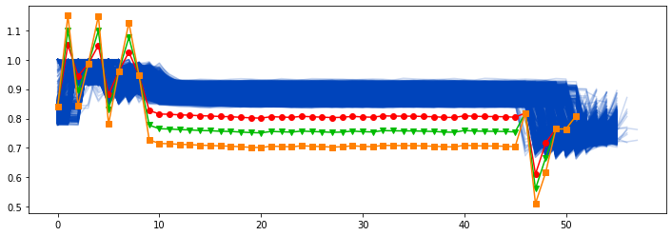
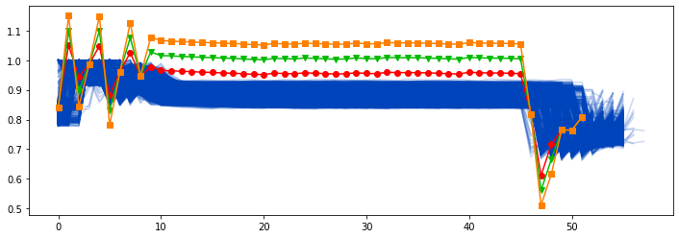
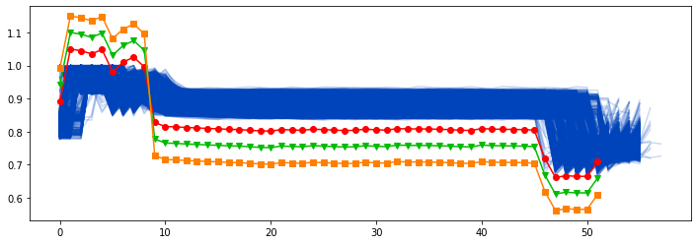
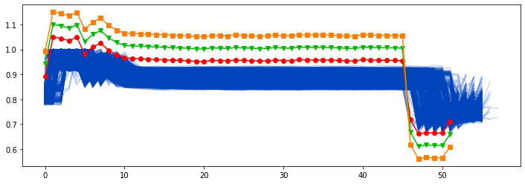
Introduction
Proposed method
Experiment result
Conclusion
Experiment design - Complexity abnormality
Complexity abnormality can be determined as sequence abnormality.
Loose belt & Bearing loss
tightened belt & Bearing loss
Loose belt & Slider loose
tightened belt & Slider loose
19

Slide 20
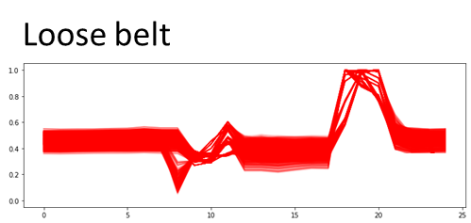
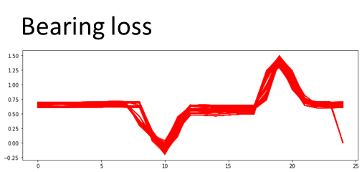
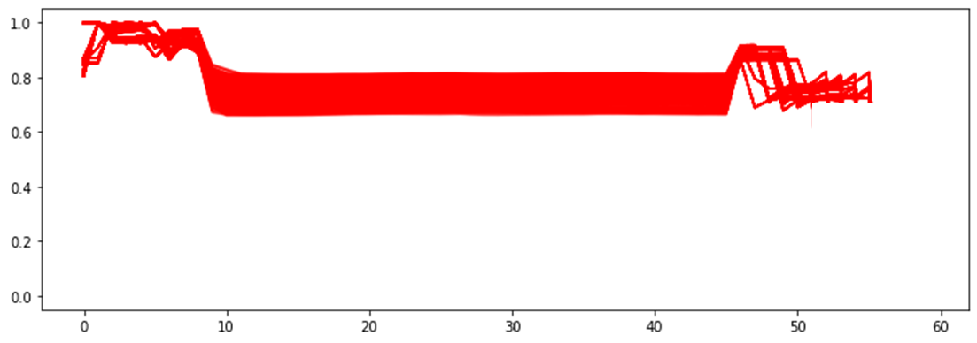
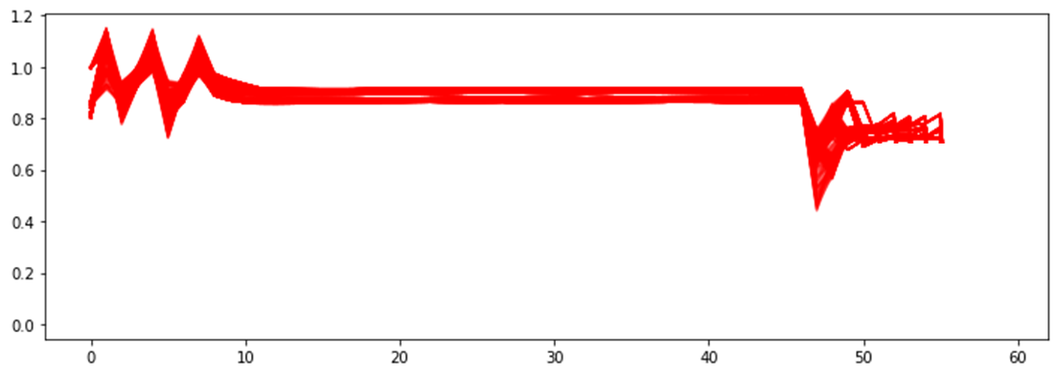
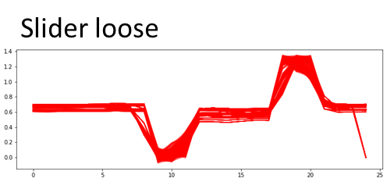
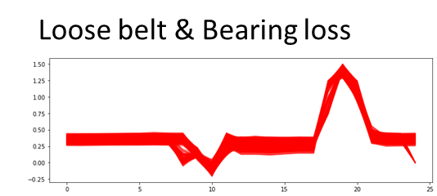
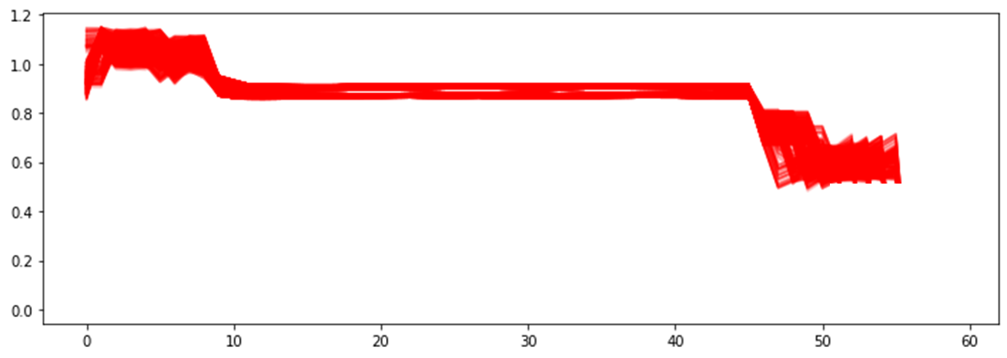
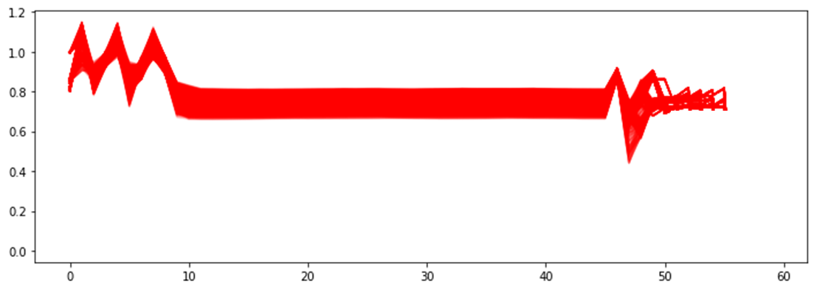
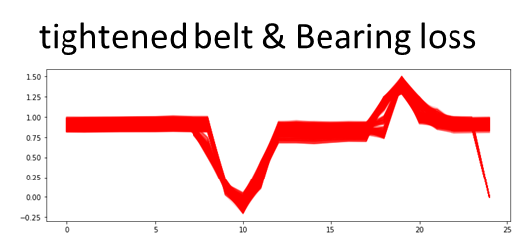
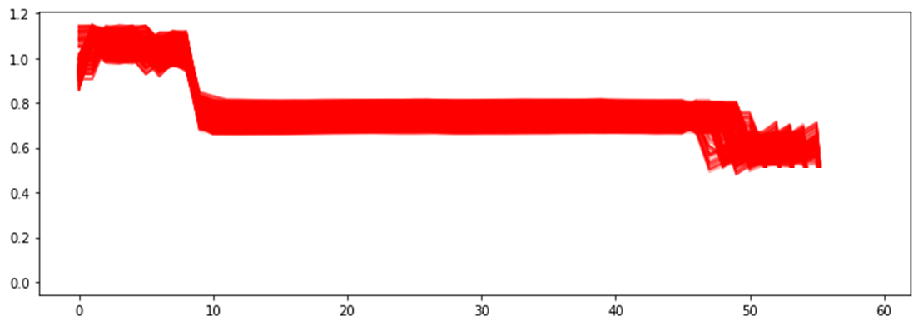
Introduction
Proposed method
Experiment result
Conclusion
Test data setting
Testing set :
No. Normal data : 704
No. abnormal data :
 |  | prediction
 |  | Abnormal | normal
True | Abnormal | TP | FN
 | normal | FP | TN
Generate 1000 records for each type of anomaly based on their degree of severity.
Repeat the testing process 10 times and average the results for evaluation.
Sample type
Normal | 704
Abnormal (total 8 type) | 100*8(each type)
Total No. sample | 1504
Each indicator use the 95th percentile of the training set results and fine-tuned with the validation
Integrated index threshold setting is 1.
20

Slide 21

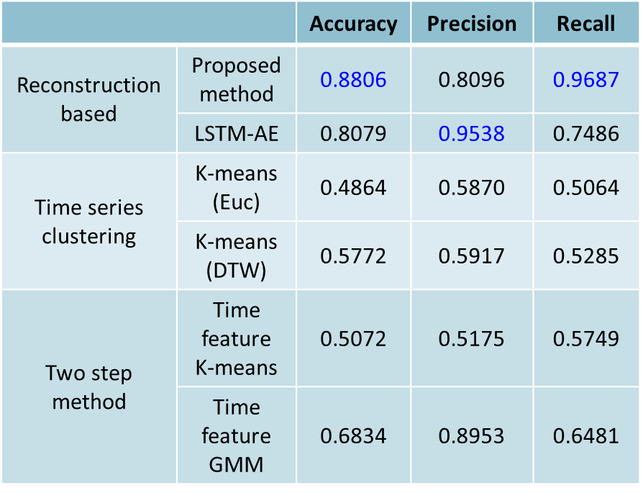
Introduction
Proposed method
Experiment result
Conclusion
Anomaly detection result - comparison
The proposed method has high accuracy, and the capability of capturing anomalies is significant, and also has the balanced performance.
The reconstruction-based autoencoders also showed good results, but its anomaly detection performance significantly differed from the proposed method.
The other methods, such as k-means based on DTW and the two-step GMM might have higher false negatives and false positives. The capability of capturing anomalies is significant decrease with proposed method.
21

Slide 22

Introduction
Proposed method
Experiment result
Conclusion
Anomaly detection result - comparison
performance metrics : Recall
Reconstruction based :
The reconstruction error is not significantly influenced by the rapid variations in shape and point anomalies, therefore the autoencoder has less ability to identify tightened belts and point anomalies.
Time series clustering ：
DTW can better capture the temporal shifts. However, techniques using Euclidean distance as the benchmark performed worse in detecting all kinds of anomalies.
Two step method：
The outcomes of these two techniques show the benefits of the suggested approach's use of DAGMM, which maximizes dimension reduction through joint training and supplies comprehensive information for subsequent density estimation.
22

Slide 23






Introduction
Proposed method
Experiment result
Conclusion
Mixed data training result
Shape index result in Real data
Shape index result in mixed
t-SNE result
Distribution index result in Real data
Distribution index result in Mixed
False Negative(FN) result in mixed data
Mixed training improves the detection of samples on the decision boundary.
Enhances the data profile of normal samples.
Optimizes the detection of anomalous samples near the boundary.
23

Slide 24




Introduction
Proposed method
Experiment result
Conclusion
Validity for each indicator
performance metrics : Recall
 | shape | distribution | instant
Loose belt | 0.8762 | 1.0000 | 0.9987
tightened belt | 0.7075 | 0.9962 | 0.9325
Bearing loss | 0.2087 | 0.4612 | 0.8750
Slider loose | 0.1600 | 0.2050 | 0.7875
Loose belt & Bearing loss | 0.9512 | 1.0000 | 1.0000
Loose belt & Slider loose | 0.9725 | 1.0000 | 1.0000
tightened belt & Bearing loss | 0.8212 | 0.9725 | 0.3487
tightened belt & Slider loose | 0.6350 | 0.9250 | 0.1962
24

Slide 25





Introduction
Proposed method
Experiment result
Conclusion
Shape indicator
For two samples with the contextual abnormality, the shape of tightened belt is more similar to the normal sample. As a result, it effects the detection capability.
performance metrics : Recall
 | shape | distribution | instant
Loose belt | 0.8762 | 1.0000 | 0.9987
tightened belt | 0.7075 | 0.9962 | 0.9325
Bearing loss | 0.2087 | 0.4612 | 0.8750
Slider loose | 0.1600 | 0.2050 | 0.7875
Loose belt & Bearing loss | 0.9512 | 1.0000 | 1.0000
Loose belt & Slider loose | 0.9725 | 1.0000 | 1.0000
tightened belt & Bearing loss | 0.8212 | 0.9725 | 0.3487
tightened belt & Slider loose | 0.6350 | 0.9250 | 0.1962
Loose belt
tightened belt
For point anomalies, which involve short and rapid changes, shape indicators have similar performance with the normal samples.
Slider loose
Bearing loss
25

Slide 26

Introduction
Proposed method
Experiment result
Conclusion
Distribution indicator
performance metrics : Recall
 | shape | distribution | instant
Loose belt | 0.8762 | 1.0000 | 0.9987
tightened belt | 0.7075 | 0.9962 | 0.9325
Bearing loss | 0.2087 | 0.4612 | 0.8750
Slider loose | 0.1600 | 0.2050 | 0.7875
Loose belt & Bearing loss | 0.9512 | 1.0000 | 1.0000
Loose belt & Slider loose | 0.9725 | 1.0000 | 1.0000
tightened belt & Bearing loss | 0.8212 | 0.9725 | 0.3487
tightened belt & Slider loose | 0.6350 | 0.9250 | 0.1962
The distribution indicator is a model's measure of the latent representation of a sample in terms of its distribution, which involves observing the overall characteristics of the sequence. point anomalies have a less significant effect on the overall characteristics, making the distribution indicator less capable of detecting point anomalies effectively.
Slider loose
Bearing loss
26

Slide 27




Introduction
Proposed method
Experiment result
Conclusion
Instant indicator
Instantaneous indicator is designed to detect the occurrence of instantaneous anomalies, with a shortage for tightened belts and belt-slider anomalies. This may be because these two anomalies exhibit peak variations that are similar to normal samples.
performance metrics : Recall
 | shape | distribution | instant
Loose belt | 0.8762 | 1.0000 | 0.9987
tightened belt | 0.7075 | 0.9962 | 0.9325
Bearing loss | 0.2087 | 0.4612 | 0.8750
Slider loose | 0.1600 | 0.2050 | 0.7875
Loose belt & Bearing loss | 0.9512 | 1.0000 | 1.0000
Loose belt & Slider loose | 0.9725 | 1.0000 | 1.0000
tightened belt & Bearing loss | 0.8212 | 0.9725 | 0.3487
tightened belt & Slider loose | 0.6350 | 0.9250 | 0.1962
27

Slide 28

Introduction
Proposed method
Experiment result
Conclusion
DMS machine 7 axis mixed training result
performance metrics : Number of false negative
 | Shape indicator |  |  | Distribution indicator
 | Real data | Mixed data | improvement | Real data | Mixed data | improvement
Axis 1 | 75 | 47(-28) | 37.3% | 519 | 534(+15) | 2.89%
Axis 2 | 236 | 103(-133) | 56.3% | 426 | 221(-205) | 48.12%
Axis 3 | 173 | 64(-109) | 63.00% | 406 | 258(-148) | 36.45%
Axis 4 | 234 | 207(-27) | 11.53% | 133 | 107(-26) | 19.54%
Axis 5 | 162 | 148(-14) | 8.64% | 594 | 503(-91) | 15.31%
Axis 6 | 10 | 4(-6) | 60.00% | 234 | 181(-53) | 22.64%
Axis 7 | 118 | 95(-23) | 19.49 | 582 | 585(+3) | 0.51%
1
TimeGAN was used in this study to create samples of the normal condition. The generated samples and real data were combined and sent into the DAGMM for training.
2
This strategy reduced false negatives for shape indicator by 8% to 63% and for distribution indicator by 15% to 48%.
28

Slide 29
Introduction
Proposed method
Experiment result
Conclusion
DMS machine 7 axis anomaly detection result
performance metrics : Accuracy
 | Clustering based | Reconstruction based | Two step method | Proposed method
Axis 1 | 0.5036 | 0.8861 | 0.6845 | 0.9232
Axis 2 | 0.7023 | 0.8617 | 0.7023 | 0.9657
Axis 3 | 0.7328 | 0.8809 | 0.5446 | 0.9117
Axis 4 | 0.5772 | 0.8077 | 0.7530 | 0.8806
Axis 5 | 0.5249 | 0.6596 | 0.6551 | 0.7294
Axis 6 | 0.8107 | 0.8575 | 0.7788 | 0.9709
Axis 7 | 0.6200 | 0.9005 | 0.5045 | 0.8978
1
In this study, a deep learning model was trained using both generated and real data. Two different types of indicators were produced by deep learning model, and a third type of indicator was created by using time-domain feature transformation.
2
This method improved in the comprehensive anomaly identification. The accuracy can average up to 90% over traditional single-faceted anomaly detection techniques.
29
 | Clustering based | Reconstruction based | Two step method | Proposed method
Axis 1 | 0.5036 | 0.8861 | 0.6845 | 0.9232
Axis 2 | 0.7023 | 0.8617 | 0.7023 | 0.9657
Axis 3 | 0.7328 | 0.8809 | 0.5446 | 0.9117
Axis 4 | 0.5772 | 0.8077 | 0.7530 | 0.8806
Axis 5 | 0.5249 | 0.6596 | 0.6551 | 0.7294
Axis 6 | 0.8107 | 0.8575 | 0.7788 | 0.9709
Axis 7 | 0.6200 | 0.9005 | 0.5045 | 0.8978

Slide 30




Introduction
Proposed method
Experiment result
Conclusion
DMS machine 7 axis Recall
LD LOW
 | Clustering based | Reconstruction based | Two step method | Proposed method
 | Recall | Recall | Recall | Recall
TR UNIT | 1.0000 | 0.9993 | 0.5508 | 0.9095
LD UP Y | 0.6376 | 0.9431 | 1.0000 | 0.9446
LD UP Z | 0.6711 | 0.9574 | 0.4357 | 0.8963
LD LOW | 0.5917 | 0.7442 | 0.6481 | 0.9687
UL UP Y | 0.5619 | 0.6123 | 0.6181 | 0.7785
UL UP Z | 0.9768 | 0.7346 | 0.6940 | 0.9908
UL LOW | 0.6539 | 0.8836 | 0.5254 | 0.8660
TR UNIT
The study's data show differences in numerical magnitudes and temporal durations. As a result, in some axis, normal samples might be misunderstood for anomalies because of the shifting.
UL UP Y
Improvements direction
Data Alignment
Considering Relevant Features
30

Slide 31



Introduction
Proposed method
Experiment result
Conclusion
DMS machine 7 axis Precision
LD LOW
 | Clustering based | Reconstruction based | Two step method | Proposed method
 | Precision | Precision | Precision | Precision
TR UNIT | 0.3218 | 0.7807 | 0.6971 | 0.9477
LD UP Y | 1.0000 | 0.8201 | 0.6376 | 0.9895
LD UP Z | 0.9986 | 0.7840 | 0.5914 | 0.9403
LD LOW | 0.5285 | 0.9588 | 0.8953 | 0.8096
UL UP Y | 0.4275 | 0.9209 | 0.8934 | 0.6761
UL UP Z | 0.7457 | 1.0000 | 0.9663 | 0.9518
UL LOW | 0.6805 | 0.9488 | 0.5577 | 0.8480
UL LOW
UL UP Y
This study also focuses on identifying anomalies that demonstrate significant changes. Therefore, further research will be needed to verify the proposed method's capacity to identify certain abnormalities, such as those demonstrating growing changes.
31

Slide 32
Introduction
Proposed method
Experiment result
Conclusion
Conclusion
Point abnormality
For point anomalies, it is recommended to use time-domain feature analysis and select appropriate features for analysis. It is worth noting that point anomalies with sufficiently distinct differences can also be distinguished using reconstruction-based methods.
Contextual abnormality
Contextual anomalies are anomalies that exhibit unexpected behavior within a sequence. Therefore, methods like clustering or density estimation are more likely to observe differences in such cases.
Sequence abnormality
Sequence anomalies are anomalies that exhibit similar patterns but with different numerical values. Therefore, differences are more likely to be observed in terms of reconstruction error measurement and density estimation. It's important to note that in certain situations, the detection capability of density estimation methods might be weaker.
32

Slide 33
Introduction
Proposed method
Experiment result
Conclusion
Conclusion
This study provides a multifaceted unsupervised learning-based anomaly detection framework, to address the problem of modeling anomalies in real-world situations where the process is restricted by a shortage of anomalous samples.
1
2
It is possible to improve the data profile of normal state by using generative models to generate different normal samples. False negatives reduced 8% to 63% for shape indicator, 15% to 48% for distribution indicators.
Instantaneous indicators overcome the shortcoming of shape and distribution indications in point anomalies. The shape and distribution indicators compensate for the instantaneous indicator‘s weaknesses in detecting complexity anomalies. Accuracy can average up to 90% .
3
33

Slide 34
Introduction
Proposed method
Experiment result
Conclusion
Execution Results
 | As-Is | To-Be | Benefit
生成資料混合訓練 | 設備異常的紀錄鮮少 | 生成正常樣本和真實數據資料進行混合訓練 | 使異常偵測模型能學習正常樣本完整之資料輪廓 改善決策邊界樣本的偵測能力。形狀指標漏檢率有8% - 63% 的下降，分佈指標下降15%-48%
異常偵測 | 傳統監督式學習方法 非監督式機器學習方法 | 使用非監督式深度學習框架LSTM-DAGMM，透過深度學習模型在學習時間序列資料非線性特徵同時擬合正常資料之資料分佈 將資料進行時域特徵之轉換，觀察序列在短時間變化之表現 | 非監督式學習無須進行資料標記 DAGMM透過深度學習之特性進行重構學習和密度估計的聯合優化。壓縮網路進行序列表現的學習，估計網路進行資料分佈之學習 時域轉換特徵捕捉正常狀態下瞬時變化之界線
 | 單一指標進行異常偵測 | 建構三種異常偵測指標進行偵測，DAGMM生成形狀指標以及分佈指標，瞬時指標由時域特徵轉換而成，由三種指標進行多面向異常偵測。 1.形狀指標：序列原始表現之異常 2.分佈指標：序列潛在特徵分佈之異常 3.瞬時指標：序列在短時間變化之異常 | 利用三種指標進行多面向之異常偵測，三種指標能夠互補相互不足的地方。和以往單一面向進行偵測的方法相比，準確率平均達到9成
34

Slide 35

設備異常偵測模型於時間序列資料之研究
友達光電 & 國立臺灣科技大學 產學合作研究
許嘉裕博士*、莊佳臻研究生
人工智慧與決策分析研究室(AIDA)
* cyhsu@gapps.ntust.edu.tw

Slide 36
THANK YOU

Slide 37
Introduction
Proposed method
Experiment result
Conclusion
DMS machine 7 axis anomaly detection result
 | Clustering based |  | Reconstruction based |  | Two step method |  | Proposed method
 | Recall | Precision | Recall | Precision | Recall | Precision | Recall | Precision
TR UNIT | 1.0000 | 0.3218 | 0.9993 | 0.7807 | 0.5508 | 0.6971 | 0.9095 | 0.9477
LD UP Y | 0.6376 | 1.0000 | 0.9431 | 0.8201 | 1.0000 | 0.6376 | 0.9446 | 0.9895
LD UP Z | 0.6711 | 0.9986 | 0.9574 | 0.7840 | 0.4357 | 0.5914 | 0.8963 | 0.9403
LD LOW | 0.5917 | 0.5285 | 0.7442 | 0.9588 | 0.6481 | 0.8953 | 0.9687 | 0.8096
UL UP Y | 0.5619 | 0.4275 | 0.6123 | 0.9209 | 0.6181 | 0.8934 | 0.7785 | 0.6761
UL UP Z | 0.9768 | 0.7457 | 0.7346 | 1.0000 | 0.6940 | 0.9663 | 0.9908 | 0.9518
UL LOW | 0.6539 | 0.6805 | 0.8836 | 0.9488 | 0.5254 | 0.5577 | 0.8660 | 0.8480
1
Precision is the capacity to correctly identify normal events, while Recall is the capacity to detect anomalies. Performance on all axes is balanced for the proposed method.
2
On the other hand, other methods have a bias towards one of these metrics, which may lead to more false positives or false negatives in their identification.
3
Although the performance of the proposed method is mostly balanced, there are still some false negatives and false positives exist. In the following parts, this will be discussed in more detail.
37

Slide 38
Introduction
Proposed method
Experiment result
Conclusion
Conclusion
False negative situation
False positive situation
The study's data show differences in numerical magnitudes and temporal durations. As a result, in certain cases, normal samples might be misunderstood for anomalies.
The anomalous samples utilized in this study’s inference phase were produced by experimental design.
Certain samples may be labeled as anomalies by the definition after the addition of noise components, yet they may actually be normal samples.
Improvements direction
Data Alignment
Aligning the data in a specific manner. It could potentially impact the results of model training.
This study also focuses on identifying anomalies that demonstrate significant changes. Therefore, further research will be needed to verify the proposed method's capacity to identify certain abnormalities, such as those demonstrating growing changes.
Considering Relevant Features
The performance of the model could be improved by adding pertinent features to the estimation network of the DAGMM as well as the time-domain features.
38

